Slide 1
Cattle Health Monitoring System

Slide 2
Main Parameters to Monitor
Body temperature
Rumination
Movement
Goal: To detect illness and artificial insemination time

Slide 3
Cattle Body Temperature
For hundreds of years the concept has remained the same fever = illness
If we can continuously monitor cattle body heat we can:
Detect illnesses three to five days sooner
Increase milk production
Reduce treatment costs
Reduce mortality rates
Improve production efficiency
The start of the estrous cycle can be determined through proper data analytics and body temperature monitoring

Slide 4
Cattle Rumination
On average, cows ruminate from 400 to 600 minutes per day
Each cow has unique rumination habit
A change in routine rumination is almost always noteworthy
Typically spends less time ruminating when ill

Slide 5
Cattle Movement
An estrous cow usually stands to be mounted 20 to 55 times during her estrous period.
Each mount lasts three to seven seconds
Cows in heat are more restless and alert to their surroundings
Research shows that cows in heat spend less time resting than nonestrous herdmates
Cattle may bellow more frequently during estrus

Slide 6
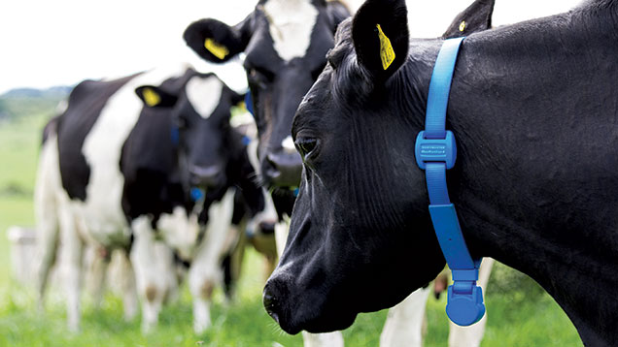
Monitoring Body temperature, Rumination and Movement
Fever tag @ ear
Rumination and Movement collar @ neck

Slide 7
Technical Overview
Heat Sensor to monitor body temperature
Sound Sensor as Rumination Detector
MCU
Wi-Fi
Server/DB
Mobile/Web App
Accelerometer as movement sensor

